Slide 1

File and Printer sharing in Windows NT Environment
NATIONAL INSTITUTE OF ELECTRONICS AND INFORMATION TECHNOLOGY
Birla Farms, Bada Phull, Ropar
NIELIT ‘O’-Level
IT Tools and Network basics

Slide 2
Tables

Slide 3
Index
Tables
Introduction
What is a table?
Insert Table
Draw Table
Table Manipulation :Table Layout formatting
inserting and deleting rows and columns
merging and splitting individual cells
adjusting sizes of rows and columns
Resizing the table and its position on the page
Table formatting
Changing cell width and height
Alignment of Text in cell
Border and Shading
Number Formats
Protect Cells
Sorting
Calculations in tables

Slide 4
Introduction
Tables are a useful way to organize and present large amounts of information, for example:
Technical, financial, or statistical reports.
Product catalogs showing prices and characteristics.
Lists of names with address and other information.
Tables can also be used to create more complex layouts in a page and position and align text and graphics

Slide 5
What is a table?
A table consists of rows and columns. Usually the first row contains a header with the names of the columns. Each row or column contains cells where we insert the table data (text or graphics).
SNo. | First Name | Last Name | City | Contact
1 | Arun | Verma | Delhi | 425690
2 | Ajay | Kumar | Mumbai | 428696
3 | Misha | Bhatia | Lucknow | 472366

Slide 6
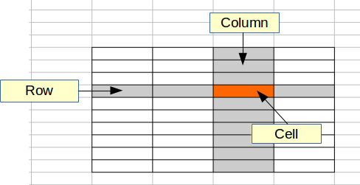
What is a table?
A row is a horizontal series of cells, while a column is a vertical series.

Slide 7
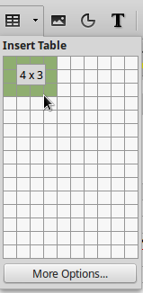
Inserting a new table
Quick insert
To quickly insert a table with the default properties, click the Insert Table icon on the Standard toolbar.
On the drop-down graphic, choose the size of the table.

Slide 8
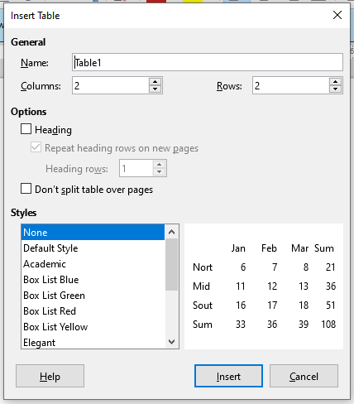
Inserting a new table
Using the Insert Table Dialog
To open the table dialog, use one of the following method:
Choose Table > Insert Table from the Menu bar.
Press Ctrl+F12.
On the Standard toolbar, click the Insert Table icon
and select More Options at the bottom of the drop-down graphic.

Slide 9
Inserting a new table
Heading. Select this option if the first row of the table contains the names of the columns and not actual data. This makes the first row as a heading
Repeat Heading Rows on new pages. Makes the heading row to appear in every page if the table is large enough.
Don’t split table over pages. Prevents the table from spanning more than one page.
Border. Surrounds each cell of the table with a border.

Slide 10
Create a table from formatted text
We can create a table from plain text by using the Text to Table tool. The text to be converted must contain characters to indicate column separators. Paragraph marks, indicate the end of a table row.
For the example the text below separates columns with commas (,) and rows with paragraphs.
Name, City, Age Arun, Verma, 23 Ajay, Kumar, 25 Misha, Bhatia, 16

Slide 11
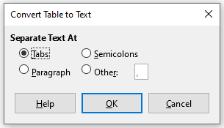

Create a table from formatted text
Select the text and choose the Table > Convert > Text to Table menu command.
When the Convert Text to Table dialog appears we set commas as separator.

Slide 12
Draw a table

Slide 13
Table Manipulation
Formatting a table is, a two-step process:
formatting of the table layout
formatting of the table text

Slide 14
Table Layout Formatting
Formatting the layout normally involves one or more of the following operations:
inserting and deleting rows and columns
merging and splitting individual cells
adjusting sizes of rows and columns
adjusting the size of the table and its position on the page

Slide 15
Insert rows and columns
To insert rows and columns, use the corresponding buttons on the Table toolbar. First place the cursor in a cell and then select one of the following commands:
 | insert row above
 | insert row below
 | insert column left
 | insert column right

Slide 16
Delete table, rows and columns
To delete rows and columns or the whole table, use the corresponding buttons on the Table toolbar. First place the cursor on a row or column you want to delete, and then select one of the following functions.
 | delete row
 | delete column
 | delete table

Slide 17

Selections inside a table
You can select a cell, a group of cells, a row, a column or the whole table using the standard mouse click and drag technique.
To quickly select a row or a column place the mouse pointer just outside the row or column and click.
To quickly select a cell click the Select cell button on the Table toolbar.
To quickly select all table cells, click the Select table button
Select cell
Select table

Slide 18

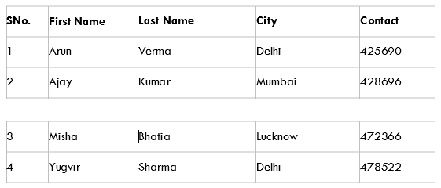
Merge and Split
Splitting a table
To split a table in two, click inside the first row of the second table and click the Split table button from the Table toolbar.
Split table

Slide 19

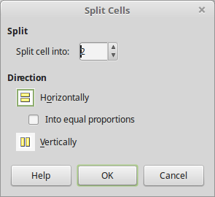
Splitting and merging cells
The split and merge tools allow us to create more complex table layouts.
To split, first select a cell and then click on the split cell button. In the dialog choose the number of cells to split into and direction. The horizontal direction will divide the cell into rows, while the vertical in columns.
Split Cells

Slide 20


Splitting and merging cells
To merge, select your cells and click the merge button.
Merge Cells

Slide 21
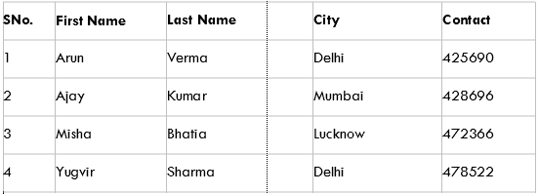
Resizing tables
Resizing row height and column width.
To resize the height of a row or width of a column simply place your mouse over the row or column border and when the resize pointer appears drag the line to the new position.

Slide 22



Resizing Tables
Optimize table size
The optimize table size tool help us to automatically change size of columns and rows.
The tool provides the following functions:
Optimize row height or column width
Resizes the row height or column width to fit the contents in the smallest possible size.
Distribute rows or columns evenly
Changes sizes in a way that all rows have equal height and all columns have equal width.

Slide 23
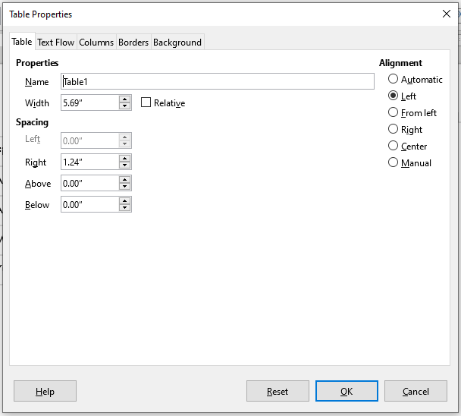
Table alignment
To vertically align a table click on Table properties button to open the Table format window
In this window you can set the alignment (left, center, right, automatic). The default alignment is automatic which means that the table occupies the full width of the page. In the window you can also set the distance from the page borders (spacing) of the table.

Slide 24


Alignment of Text in Cell
Once the table layout is satisfactory, one can format the text in the individual cells. You can format each cell independently of other cells, or you can simultaneously format a group of cells by selecting them before applying the desired formatting.
Alignment
Table cells can be aligned both vertically and horizontally. To align horizontally use the horizontal alignment buttons from the Formatting toolbar.
To align vertically use the vertical alignment buttons from the Table toolbar.

Slide 25
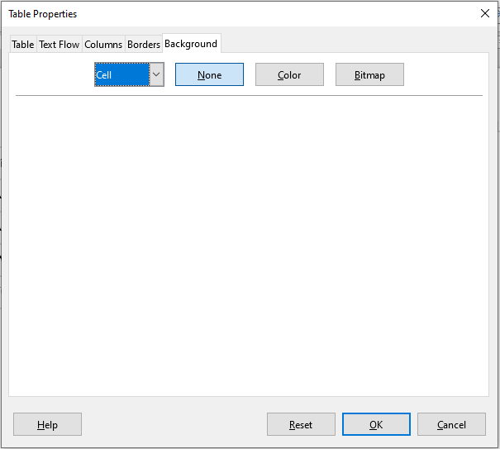
Borders and Shading

Slide 26
Borders and Shading
Table background can improve the readability of data, visually highlight important parts of the table (such as the heading or a specific cell), or just make the table more appealing.
You can choose between two types of background: solid color or image.
The background can be applied to the whole table, to a single cell, or to a row.
To set the background for a cell, row, or table:
Place the cursor anywhere inside the cell, row, or table you want to work with.
If you want to apply a background to a group of cells, select the group.
Right-click and choose Table Properties from the context menu, or choose Table > Properties from the Menu bar.
In the Table Properties dialog, select the Background tab

Slide 27
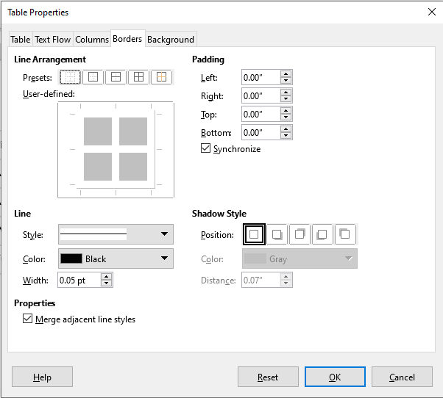
Borders and Shading
We can apply borders to any cell or group of cells using the table borders buttons in Table toolbar.
Or Open the Table Properties dialog, select the Borders tab. Here you can set borders for a whole table or groups of cells within a table.

Slide 28

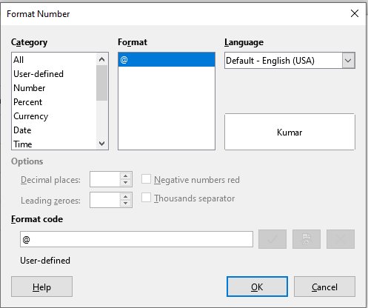
Number Format
Numerical data can be formatted into various formats. For example, cells can be set to display in a particular currency, to percentage, to 2 decimal places. To quickly format numbers in a table use the number format buttons. For more options open the Number Format dialog window.

Slide 29

Protect Cells
Protecting a cell prevents the user from accidentally changing the data. This can be useful when you want the users to edit only part of the table.
To protect a cell, select it and then click on the Protect Cells button.
To cancel the protection click on the Unprotect Cells button.

Slide 30
Sorting
Writer allows data in a table to be sorted. Up to three levels of sorting can be specified. For example, sort first by age numerically, then alphabetically by name within each age.
To sort data in a table:
Select the table (or part of the table) to be sorted.
Select the Sort icon from the Table toolbar.

Slide 31
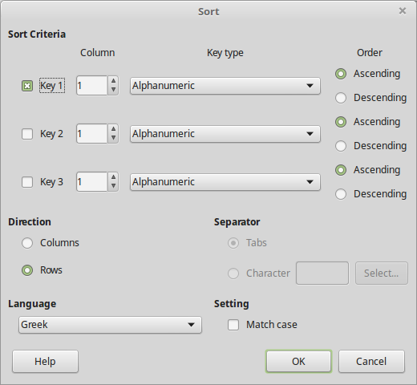
Sorting
In the Sort dialog:
Select the column number (key) to be sorted.
Select up to three keys to sort on, in the correct order.
For each key, select whether the sort is Numeric or Alphanumeric and whether it is Ascending or Descending.

Slide 32
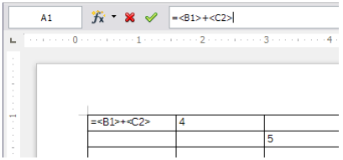
Calculations in Text Documents
You can insert a calculation directly into a text document or into a text table. Like spreadsheet, each table cell is identified by a letter (for the column) and a number (for the row). For example, cell A3 is the cell in the first column from the left and third row from the top.
Click in the document where you want to insert the calculation, and then press F2. If you are in a table cell, type an equals sign =.
Type the expression you want to be calculated, for example, =140/15, and then press enter.
You can also click the Formula icon on the Formula Bar, and then choose a function for your formula.
To refer cells in a Writer text table, enclose the cell address or the cell range in angle brackets. For example, to reference cell A1 from another cell, enter =<A1> into the cell.

Slide 33
Calculating Cell Totals in Tables
Go to Insert menu -> Table, and insert a table.
Type a number in each cell of the column, but leave the last cell in the column empty.
Place the cursor in the last cell of the column, and then click the Sum icon on the Table Bar. The Formula Bar appears with the entry "=sum".
Click in the first cell of the series you want to sum up, drag to the final cell, and then release. LibreOffice inserts a formula for calculating the sum of the values in the current column.
Press Enter, or click Apply in the Formula bar. The sum of the values in the current column is entered in the cell.
If you enter a different number anywhere in the column, the sum is updated as soon as you click in the last column cell.
Similarly, you can also quickly calculate the sum of a row of numbers.

Slide 34
Calculating Complex Formulas in Text Documents
You can use predefined functions in a formula, and then insert the result of the calculation into a text document.
For example, to calculate the mean value of three numbers, do the following:
Click in the document where you want to insert the formula, and then press F2.
Click the Formula icon, and choose "Mean" from the Statistical Functions list.
Type the three numbers, separated by vertical slashes (|).
Press Enter. The result is inserted as a field into the document.
To edit the formula, double-click the field in the document.

Slide 35
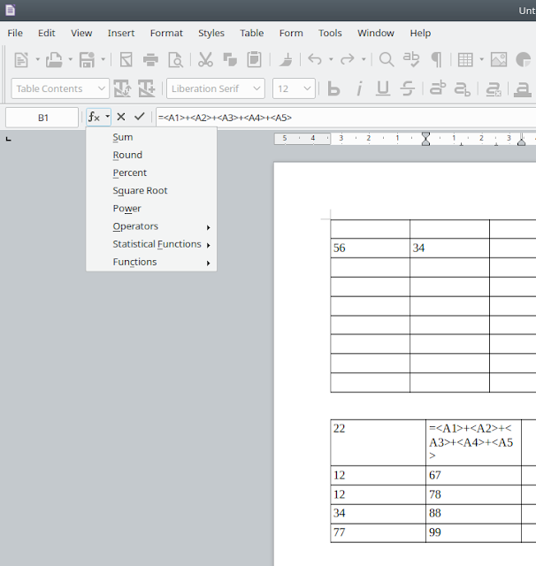
Calculations inside Writer tables
There are only few functions for use inside Writer tables, but LibreOffice Calc has over 400 functions.
To start use functions inside Writer tables you should left click into cell and then press key F2 or "=" on keyboard, or use "Formula" icon on Table toolbar. It shows a Formula bar like in the Calc.

Slide 36
Calculations inside Writer tables
The formula bar contains:
Cell address field
Functions drop-down list
Cancel button
Apply button
Formula field
Note, links to cells in Writer tables look as <A1> or <B3>. Cell ranges look as <A1:A10> or <A1:D12>.
After the Formula bar appeared you can select functions from drop-down list or can write a formula manually inside the Formula field after equal sign at once.
You can make calculates not only inside one Writer table. You can use values from many tables inside one Writer document. Use link to cell with table name like <Table2.A1>.
Note:
If you made in your formula a link to cell from another table and then changed that table's name, then you'll see an error in the cell like "** Expression is faulty **"!

